Slide 1
Spam classifier project
Guillem Gili i Bueno

Slide 2
Dataset
BOW model representation without access to the vocabulary -> We cannot use models that work on natural text
Unbalanced dataset: 80% of spam vs 20% of non-spam
Max 0.002 on FP/(TN+FP)
No missing values on X or y
X is sparse
Only 2 types of value:
Occurrences (Integer) as X (1000*57173 cells)
Class (spam = +1, non-spam = -1) as y (1000*1 cells)

Slide 3
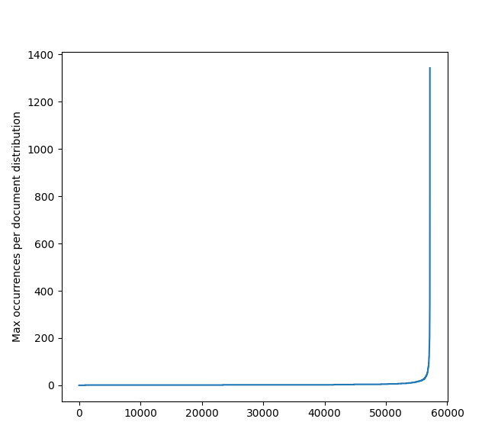
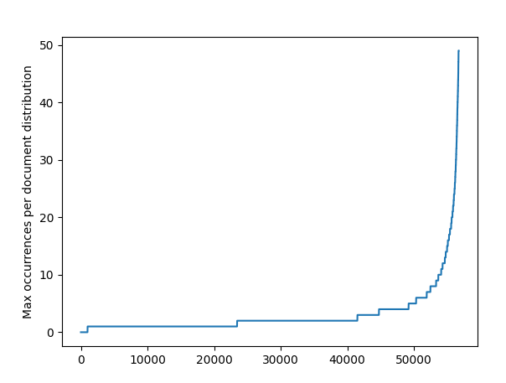
Document max occurrences of a word

Slide 4
Data preprocessing
Data preprocessing:
Migrating data format to pandas
Split: Training 60% Validation 20% Testing 20% (with a seed)
Outputs: replace -1(non-spam) to 0, turn to Bool
Inputs: Normalize all values above 50 to 50.
Inputs: Discretize values between classes 0..5
10k
Step 2
6k
2k
2k
[-1,1,1,-1]
Step 3
[0,1,1,0]
[200,0,32,3]
Step 4
[50,0,32,3]
Step 5
[5,0,4,1]

Slide 5
Approach
Decision tree baseline:
Trivial hyperparameter search (going to max depth)
More vulnerable to unbalance
May provide explainability for Random Forest
Random Forest as main model:
Simple technique but powerful
Complex enough to solve this problem
Easy to avoid overfitting
Both
A huge amount of features is no issue
How much power does ensemble add?
No “split leaf” issue

Slide 6
Results
Random Forest (hyperparameter search):
50~500 trees
50~500 depth
Tested criterion but no relevant differences; Gini
Balanced weighting for samples
Results(Validation):
F1= 0.99752
FP/(TN+FP) = 1.4%
Results(Testing):
F1= 0.99721
FP/(TN+FP) = 1.5%
Decision Tree (no search):
Gini criterion, max depth
Balanced weighting for samples
No pruning
Results(Validation):
F1= 0.99354
FP/(TN+FP) = 2.8%
Results(Testing):
F1= 0.9938
FP/(TN+FP) = 2.57%
Neither model was able to pass the FP/(TN+FP) test !!!

Slide 7
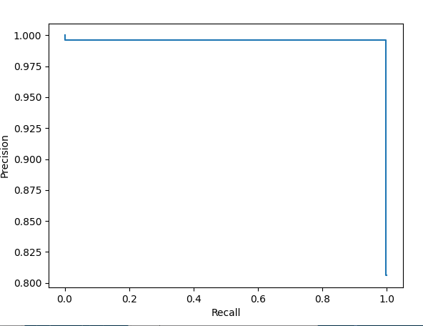
Precision~Recall

Slide 8
Conclusions
Ensembling methods provide a better performance, at the cost of explainability
While performance is good(99% F1), under the goal(0.002)
Discretization did not improve results
  Weigthing should be higher on the minority, rather balanced
  Acquiring more data (non-spam should be easier to acquire)
Parameter tuning was only marginally relevant in RandomForests

